Slide 1

Commercial Umbrella Insurance

Slide 2
Objectives
To provides an overview on what is Excess liability and Commercial Umbrella insurance and why it is required
To provide an understanding on three types of Commercial excess liability Insurance
To provide an understanding on provisions in Commercial Umbrella and how it is different from other liability policies
Note: All Information contained herein is proprietary & confidential material of ValueMomentum Inc. All rights are reserved.

Slide 3
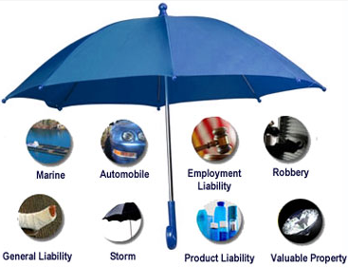
Commercial Umbrella Insurance
What is Excess liability
An excess liability policy covers liability claims in excess of the limits of an underlying policy or a stated retention amount.
What is Umbrella liability policy?
A liability policy that provides excess coverage above underlying policies and may also provide coverage not available in the underlying policies, subject to self-insured retention.
Overview
Three forms of Excess liability Insurance
Umbrella Insurance and its functions
Note: All Information contained herein is proprietary & confidential material of ValueMomentum Inc. All rights are reserved.
Notes:
What is commercial umbrella policy? –
https://www.youtube.com/watch?v=seIk3qRccbM
https://www.youtube.com/watch?v=-4mJICy2FDE

Slide 4
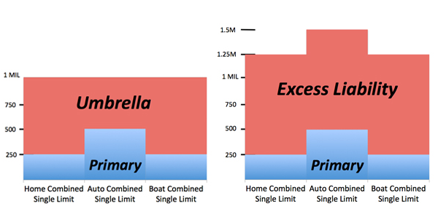
Commercial Umbrella Insurance
Three Forms of Commercial excess liability Insurance
“ following form” subject to the same term as the underlying policy and covers
liability loss that exceeds the underlying limits
“ self-contained policy” subject to its own terms only
“combination“ of the first two types
Overview
Three forms of Excess liability Insurance
Umbrella Insurance and its functions
Note: All Information contained herein is proprietary & confidential material of ValueMomentum Inc. All rights are reserved.

Slide 5
Commercial Umbrella Insurance
Umbrella Liability:
Umbrella Liability is generally used to describe a type of excess insurance that is broader than ordinary excess liability policies
The major functions of Umbrella
Excess Coverage : for losses which are covered by primary or underlying liability policies
Self Insured Retention Limit : for losses that are not typically covered by the underlying liability policies
Self insured retention is an amount that is deducted from claims that are payable under an umbrella policy and that are not covered at all by any primary policy
Overview
Three forms of Excess liability Insurance
Umbrella Insurance and its functions
Note: All Information contained herein is proprietary & confidential material of ValueMomentum Inc. All rights are reserved.

Slide 6
Thank you!!!
Note: All Information contained herein is proprietary & confidential material of ValueMomentum Inc. All rights are reserved.

